Slide 1
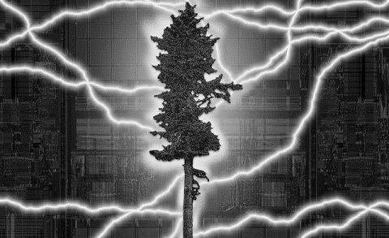

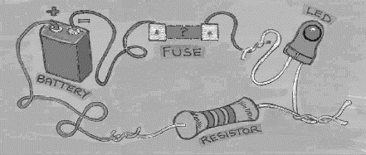
EHB222E QUESTIONS
5th week

Slide 2
For the three bipolar transistors shown below, identify which one or two devices are operated at “Forward active regions”?

Slide 3
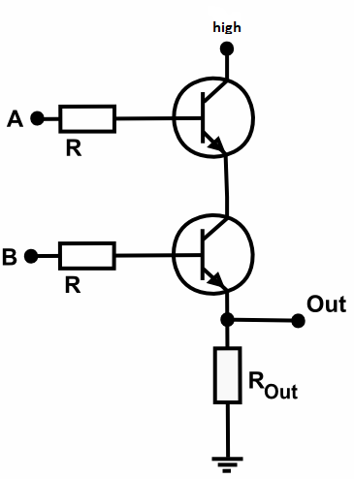
Calculate all possible output voltages for the logic circiut below. Input voltage (V_{A}, V_{B} ) values are 5V or 0V.
V_{A} | V_{B} | V_{Out}
1 | 1
1 | 0
0 | 1
0 | 0

Slide 4
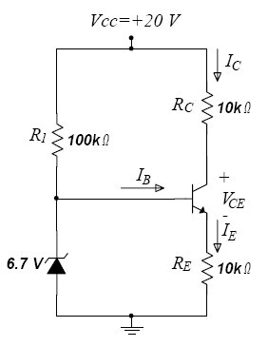
Consider the amplifier shown below. Use the following parameters for your calculations. Transistor parameters : β=200, V_{BE}=0.7V, V_{T}=25mV, V_{A}=100V. Zener diode voltage: V_{z}=6.7V a. Find diode current and operating point values of the transistor.

Slide 5
For the transistors shown below β=h_{fe} = h_{FE} = 150, V_{BE} =0.7V, and V_{T} = 25mV. All capacitors are ideal. Calculate v_{o}.

Slide 6
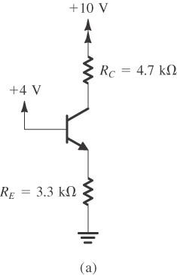
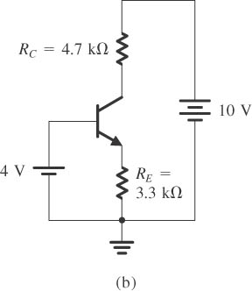
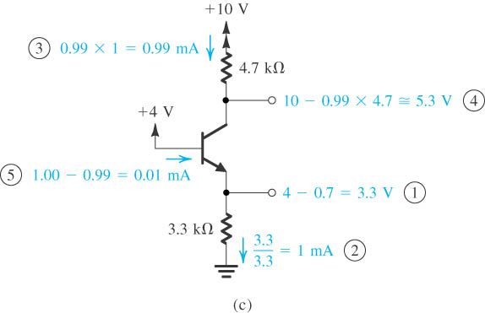
For the transistors shown below β=h_{fe} = h_{FE} = 100, V_{BE} =0.7V. Calculate operating point current and voltage values. Assume that transistor is in active mode. Check this assumption.
Works in active region
(a) circuit; (b) circuit redrawn (c) analysis with the steps numbered.

Slide 7
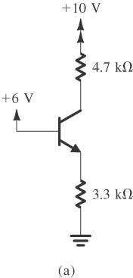
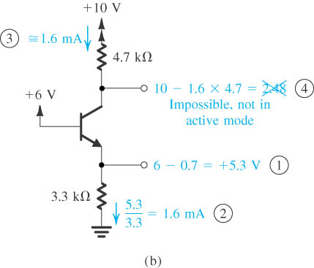
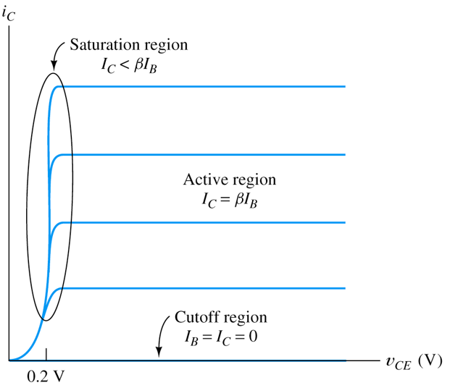
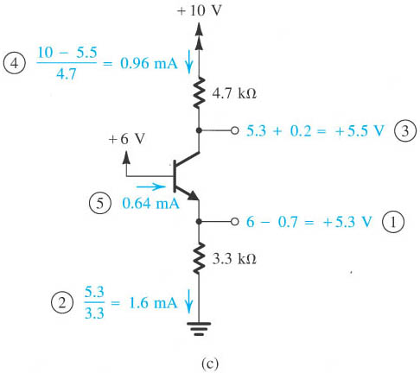
For the transistors shown below β=h_{fe} = h_{FE} = 100, V_{BE} =0.7V. Calculate operating point current and voltage values. Assume that transistor is in saturation mode. Check this assumption.
is not valid in saturation mode

Slide 8
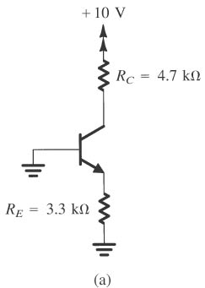
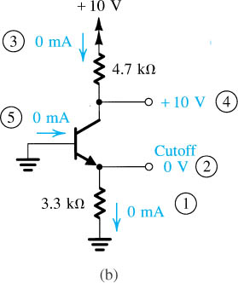
For the transistors shown below β=h_{fe} = h_{FE} = 100, V_{BE} =0.7V. Calculate operating point current and voltage values.
Works in Cutoff region

Slide 9
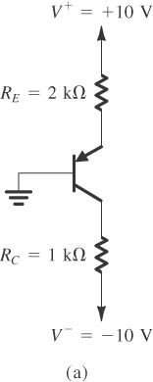
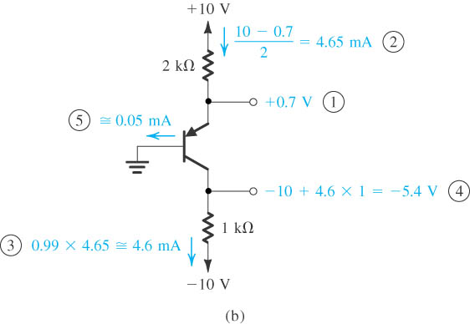
For the transistors shown below β=h_{fe} = h_{FE} = 100, V_{BE} =0.7V. Calculate operating point current and voltage values. Assume that transistor is in saturation mode. Check this assumption.
Works in active region

Slide 10
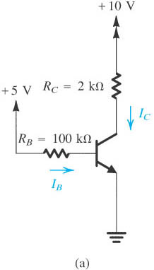
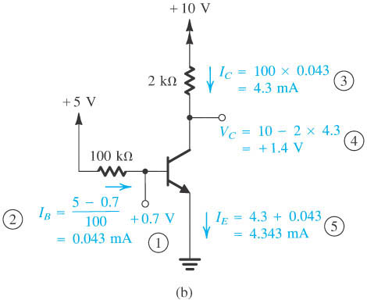
For the transistors shown below β=h_{fe} = h_{FE} = 100, V_{BE} =0.7V. Calculate operating point current and voltage values. Assume that transistor is in saturation mode. Check this assumption.
Works in active region
Notes:
sedr42021_0538a.jpg

Slide 11
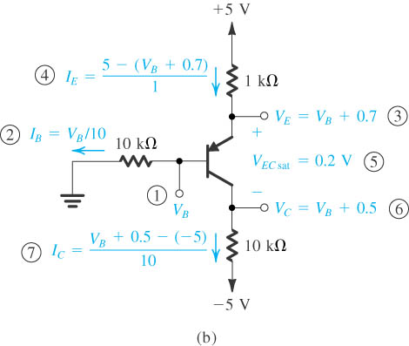
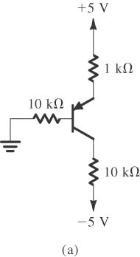
For the transistors shown below β=h_{fe} = h_{FE} = 100, V_{BE} =0.7V. Calculate operating point current and voltage values. Assume that transistor is in saturation mode. Check this assumption.
(β = 100 (active mode) ,saturation mode: V_{EC} = 0.2V).
Notes:
sedr42021_0539a.jpg

Slide 12
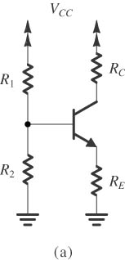
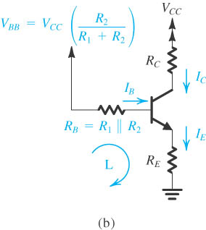
Figure Classical biasing for BJTs using a single power supply: (a) circuit; (b) circuit with the voltage divider supplying the base replaced with its Thévenin equivalent.
Notes:
sedr42021_0544a.jpg

Slide 13
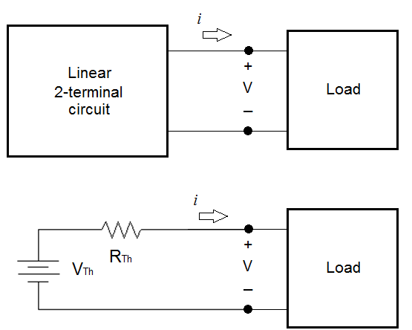
Thévenin’s Theorem
Linear circuit is a circuit where the voltage is directly proportional to the current (i.e., Ohm’s Law is followed).
A linear two-terminal circuit can be replaced with an equivalent circuit of an ideal voltage source, V_{Th}, in series with a resistor, R_{Th}.
V_{Th} is equal to the open-circuit voltage at the terminals.
R_{Th} is the equivalent or input resistance when the independent sources are turned off.

Slide 14
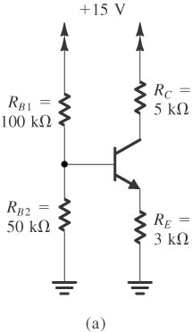
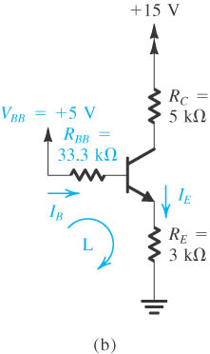
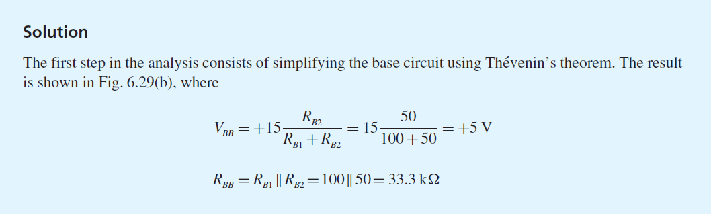
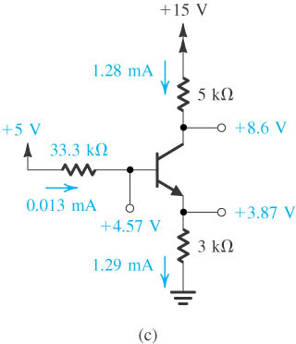
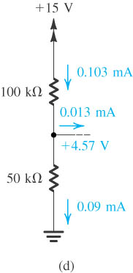
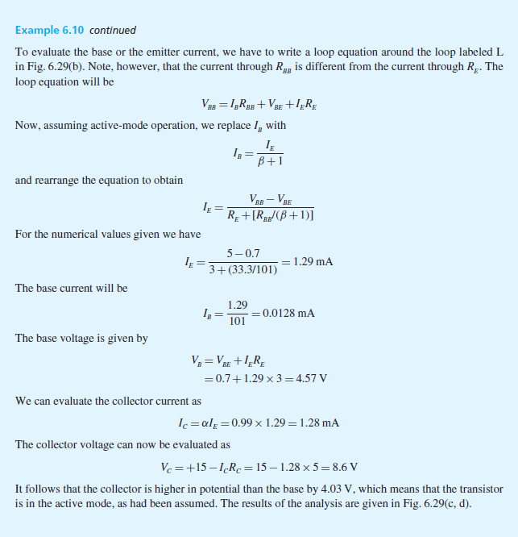
V_{Th} is equal to the open-circuit voltage at the terminals.
R_{Th} is the equivalent or input resistance when the independent sources are turned off.
Notes:
sedr42021_0540a.jpg

Slide 15
V_{Th} is equal to the open-circuit voltage at the terminals.
R_{Th} is the equivalent or input resistance when the independent sources are turned off.
Notes:
sedr42021_0540a.jpg

Slide 16
